Slide 1
ACMNA149 - Index Notation (Powers of)

Slide 2
Types of Numbers
What type of numbers do you see?

Slide 3
Types of Numbers:
Square Numbers
Square Numbers!
Why do you think these are called square numbers?

Slide 4
Types of Numbers:
Square Numbers
2x2=4
3x3=9
4x4=16
5x5=25
6x6=36
1
Have you ever heard of the term “squared” or seen this:
2
4

Slide 5
Types of Numbers:
Square Numbers/To The Power of 2
The term “squared” or “to the power of 2”:
2
4
means a number multiplied by itself:
E.g.
1² = 1x1 = 1
2² = 2x2 = 4
7² = 7x7= 49
9² = 9x9 = 81

Slide 6
Types of Numbers:
Square Numbers/To The Power of 2
1
4
9
16
25
36
Heading: Square Numbers/To The Power of 2
Complete the pattern to calculate all of the squared/to the power of 2 numbers to 12² :
2
1 = 1x1 = 1
2
2 = 2x2 = 4

Slide 7
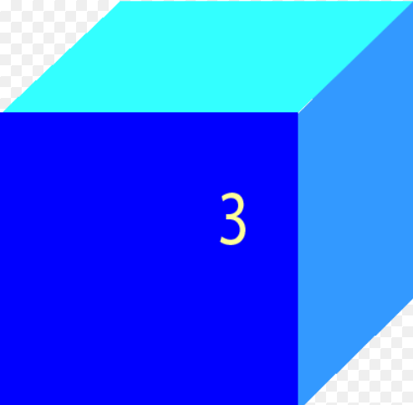
Have you ever seen this:
3
4
What does the little three (³) mean?
Cubed!

Slide 8
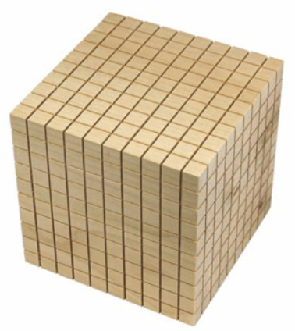
Types of Numbers:
Cubed Numbers/To The Power of 3
The term “cubed” or “to the power of 3”:
3
4
means a number multiplied by itself and then by itself again:
10
E.g.
1³ = 1x1x1 =
2³ = 2x2x2 =
7³ = 7x7x7 =
9³ = 9x9x9 =
10³ = 10x10x10 =
10
10

Slide 9
Types of Numbers:
Cubed Numbers/To The Power of 3
You can use brackets to help you solve powers of equations:
49
7³ = (7x7)x7 =
343
10
81
9³ = (9x9)x9 =
729
100
10
10³ = (10x10)x10=
1000
10

Slide 10
Types of Numbers:
To the power of…
How do we say these numbers?
7² :
5³ :
7
5 :

Slide 11
Types of Numbers:
The Power of…
Solve these powers of (showing all working out):
7 x 7 =
49
7² :
25
(
5³ :
5 x 5 x 5 =
)
125
25
625
15625
5 :
(
5 x 5 x 5 x 5 x 5 x 5 x 5 =
7
)
78125
125
3125

Slide 12
Types of Numbers:
The Power of…
Solve these “powers of ” for 10 and look for the pattern!
0
10 = 0.1
1
10 = 10
10 x 10 =
100
10² :
10³ :
10 x 10 x 10 =
1000
4
10 :
10 x 10 x 10 x 10 =
10,000
10 :
5
10 x 10 x 10 x 10 x 10 =
100,000
6
10 :
10 x 10 x 10 x 10 x 10 x 10 =
1,000,000
7
10 :
10 x 10 x 10 x 10 x 10 x 10 x 10 =
10,000,000
8
10 :
10 x 10 x 10 x 10 x 10 x 10 x 10 x 10 =
100,000,000
9
10 :
10 x 10 x 10 x 10 x 10 x 10 x 10 x 10 x 10 =
1,000,000,000
10
10 :
10 x 10 x 10 x 10 x 10 x 10 x 10 x 10 x 10 x 10 =
10,000,000,000

Slide 13
Types of Numbers:
Have you heard of the words “exponent” or “exponential”?
We can call numbers with “powers of” exponential numbers!

Slide 14
Types of Numbers:
We can call numbers with “powers of” exponential numbers!
The term “Exponential” means something becoming more and more rapid.
Viral videos on YouTube:
Once a video becomes “viral”, the number of people viewing it grows exponentially.

Slide 15
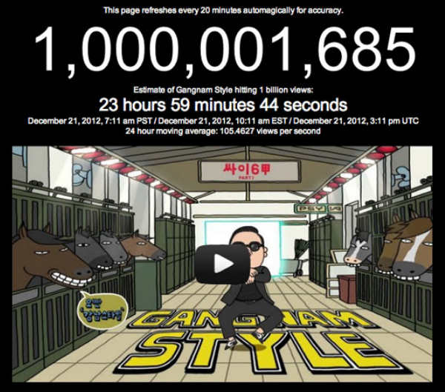
Types of Numbers:
We can call numbers with “powers of” exponential numbers!
Viral videos on YouTube:
Once a video becomes “viral”, the number of people viewing it grows exponentially.
What is “Gangnum Style”?
How do you do it?
How did you learn it?
How did its popularity grow exponentially?

Slide 16
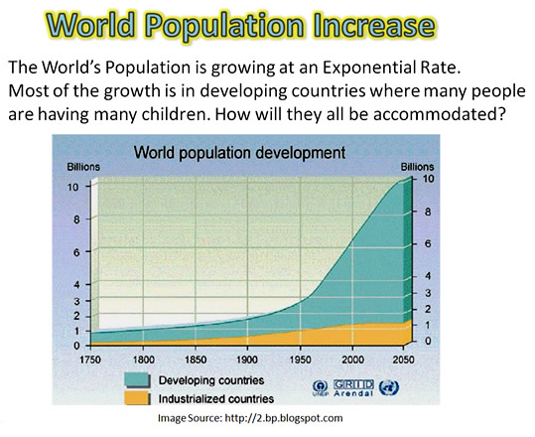
Types of Numbers:
We can call numbers with “powers of” exponential numbers!

Slide 17
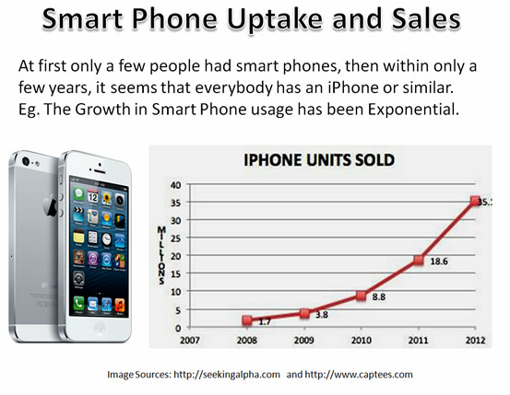
Types of Numbers:
We can call numbers with “powers of” exponential numbers!

Slide 18
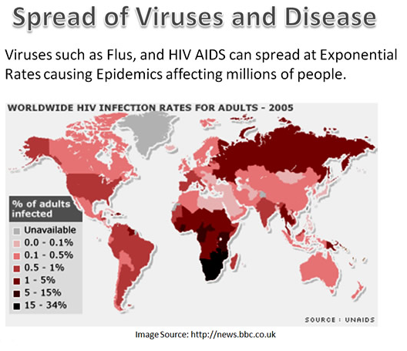

Slide 20
What would happen to the line in a graph representing exponential decrease/decline?

Slide 21
What would happen to the line in a graph representing exponential decrease/decline?

Slide 23
Types of Numbers:
10 to the power of …
Let’s take a look at how scientists use to “10 to the power of….”
This is a trip at high speed, jumping distances by factor of 10.

Slide 24
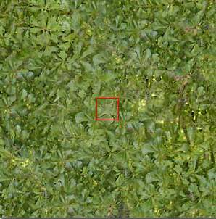
10⁰
^{1 meter}
See can see a bunch of leaves, in the garden.

Slide 25
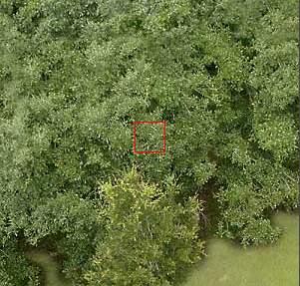
10¹
10 meters
Start our trip upwards ....
We can see the foliage.

Slide 26
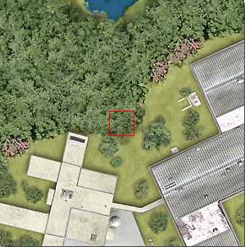
10²
100 meters
At this distance we can see the limits of the forest and the edifications.

Slide 27
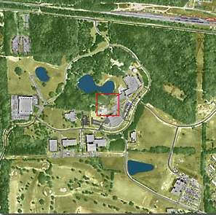
10³
1 km
We will pass from meters to kilometers..
Now it is possible to jump with a parachute ...

Slide 28
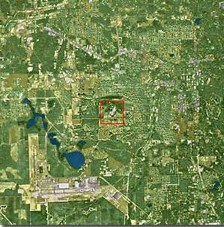
10⁴
10 km
The city can be observed but we really can not see the houses.

Slide 29
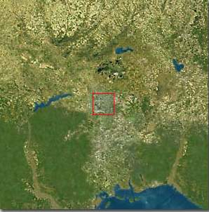
10⁵
100 km
At this height, the state of Florida - USA, can be seen..

Slide 30
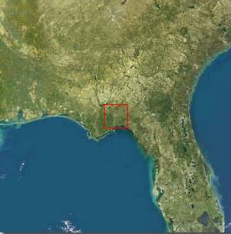
10⁶
1.000 km
Typical sight from a satellite.

Slide 31
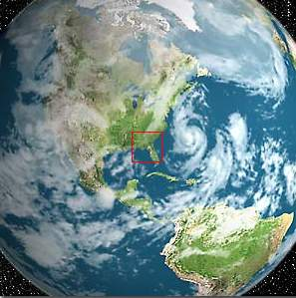
10⁷
10.000 km
The north hemisphere of Earth, and part of South America.

Slide 32
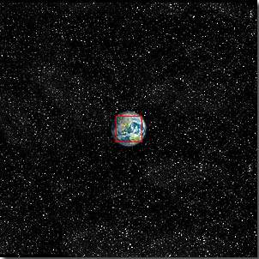
10⁸
100.000 km
The Earth starts looking small...

Slide 33
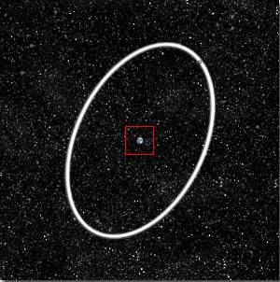
10⁹
1 million km
The Earth and the Moon’s orbit in white....

Slide 34
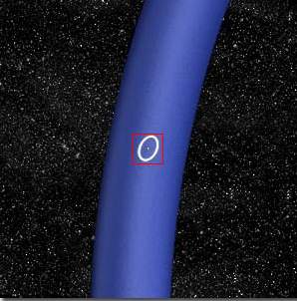
10¹⁰
10 millon km
Part of the Earth’s Orbit in blue.

Slide 35
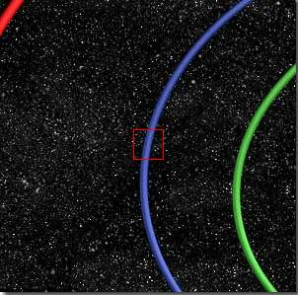
10¹¹
100 millon km
Orbits of: Venus and Earth...

Slide 36
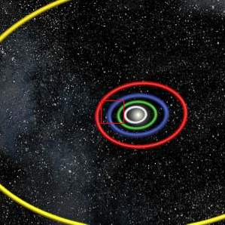
10¹²
1 billion km
Orbits of: Mercury, Venus, Earth, Mars and Jupiter.

Slide 37
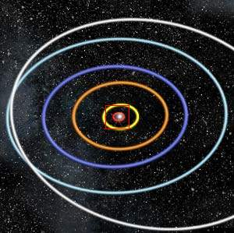
10¹³
10 billon km
At this height of our trip, we could observe the Solar System and the orbits of the planets

Slide 38
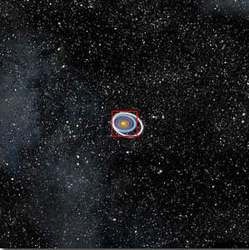
10¹⁴
100 Billon km
The Solar System starts looking small...

Slide 39
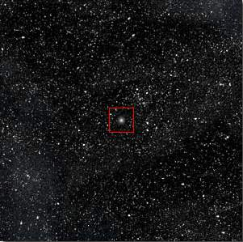
10¹⁵
1 trillion km
The Sun now is a small star in the middle of thousands of stars...

Slide 40
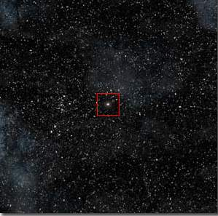
10¹⁶
1 light-year
At one light-year the little Sun star is very small

Slide 41
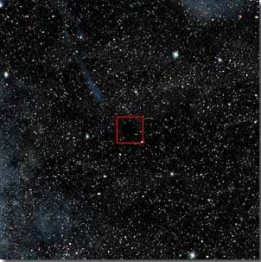
10¹⁷
10 light-years
Here we will see nothing in the infinity....

Slide 42
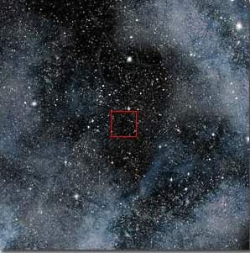
10¹⁸
100 light-years
Only stars and Nebulae...

Slide 43
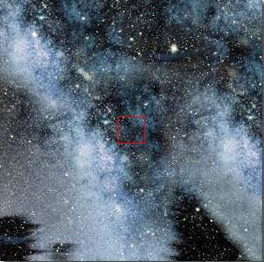
10¹⁹
1,000 light-years
At this distance we start to travel the Via-Lactea (Milky Way), our galaxy.

Slide 44
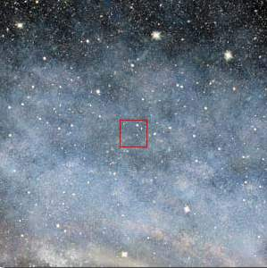
10²⁰
10,000 light-years
We continue our travel inside the Via-Lactea.

Slide 45
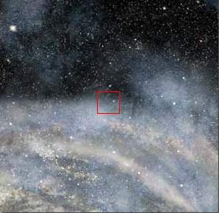
10²¹
100,000 light-years
We start reaching the periphery of the Via-Lactea.

Slide 46
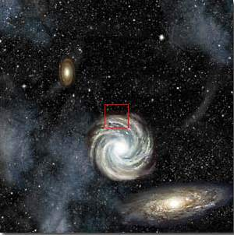
10²²
1 million light-years
At this tremendous distance we can see all the Via-Lactea & other galaxies too...

Slide 47
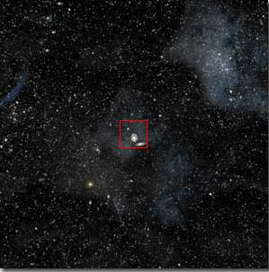
10²³ - 10 million light-years
From this distance, all the galaxies look small with inmense empty spaces in between. The same laws are ruling in all bodies of the Universe. We could continue traveling upwards with our imagination, but now we will return home quickly.

Slide 48
10²²

Slide 49
10²¹

Slide 50
10²⁰

Slide 51
10¹⁹

Slide 52
10¹⁸

Slide 53
10¹⁷

Slide 54
10¹⁶

Slide 55
10¹⁵

Slide 56
10¹⁴

Slide 57
10¹³

Slide 58
10¹²

Slide 59
10¹¹

Slide 60
10¹⁰

Slide 61
10⁹

Slide 62
10⁸

Slide 63
10⁷

Slide 64
10⁶

Slide 65
10⁵

Slide 66
10⁴

Slide 67
10³

Slide 68
10²

Slide 69
10¹

Slide 70
10⁰

Slide 71
Now let’s get microscopic!

Slide 72
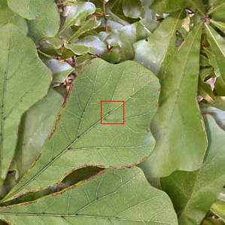
10⁻¹
10 Centimeters
Getting closer at 10 cm ...We can delineate the leaves.

Slide 73
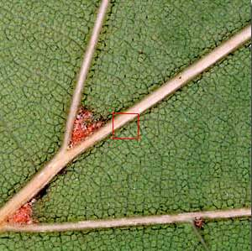
10⁻²
1 Centimeter
At this distance it is possible to observe the structure of the leaf.

Slide 74
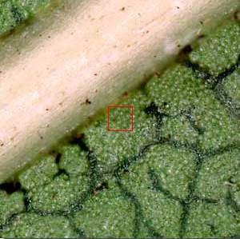
10⁻³
1 Millimeter
The cellular structures start showing...

Slide 75
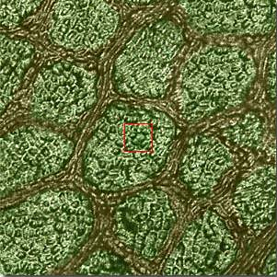
10⁻⁴
100 microns
The cells can be defined. You could see the union between them.

Slide 76
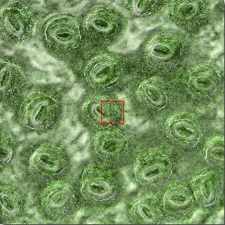
10⁻⁵
10 microns
Start our trip inside the cell...

Slide 77
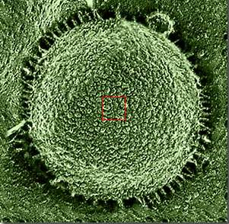
10⁻⁶
1 micron
The nucleus of the cell is visible.

Slide 78
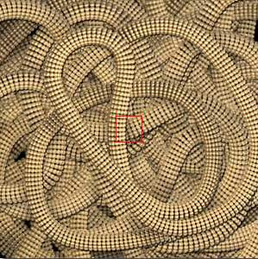
10⁻⁷
1.000 Angstroms
Again we changed the messuring unit to adapt to the minúscule size.
You could see the chromosomes.

Slide 79
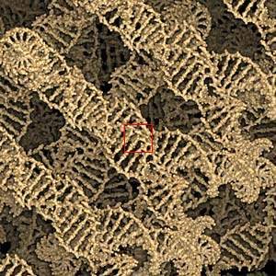
10⁻⁸
100 Angstroms
In this micro universe the DNA chain is visible.

Slide 80
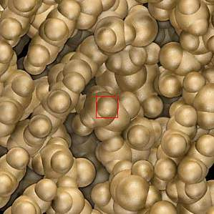
10⁻⁹
10 Angstroms
...the chromosomes blocks can be studied.

Slide 81
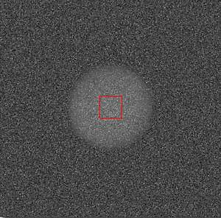
10⁻¹⁰
1 Angstrom
It appears like clouds of electrons... These are carbon atoms that formed our world. You could notice the resemblance of the microcosmos with the macrocosmos...

Slide 82
10⁻¹¹
10 picometers
In this miniature world we could observe the electrons orbiting the atoms.

Slide 83
10⁻¹²
1 Picometer
An inmense empty space between the nucleous and the electron orbits...

Slide 84
10⁻¹³
100 Fentometers
At this incredible and minuscule size we could observe the nuceous of the atom.

Slide 85
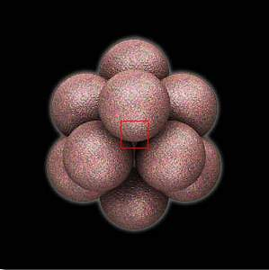
10⁻¹⁴
10 Fentometers
Now we could observe the nucleous of the carbon atom

Slide 86
10⁻¹⁵
1 Fentometer
Here we are in the field of the scientific imagination, face to face with a proton.

Slide 87
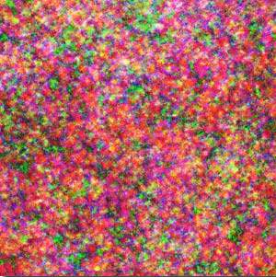
10⁻¹⁶
100 Atometers
Examine the ‘quark’ particules
There is nowhere more to go... At the limits of current scientific knowledge . This is the limit of matter...

Slide 88
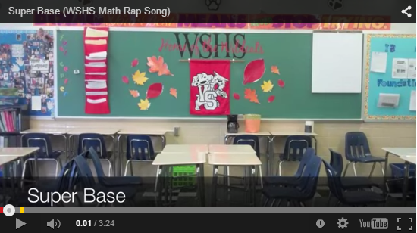
Exponents / Indices Video

