Slide 1
Kensuke’s Kingdom
Weekly Geography Task

Slide 2
The Geography in Kensuke’s Kingdom
Locate any body of water, country, city or state mentioned during this week’s chapter and:
Plot the location(s) onto the world map in your book.
Plot the journey between each destination using a dotted line and directional arrows.
Using any of the following ICT solutions
Google Maps
Google Earth
WorldWide Telescope
European Space Agency

Slide 3
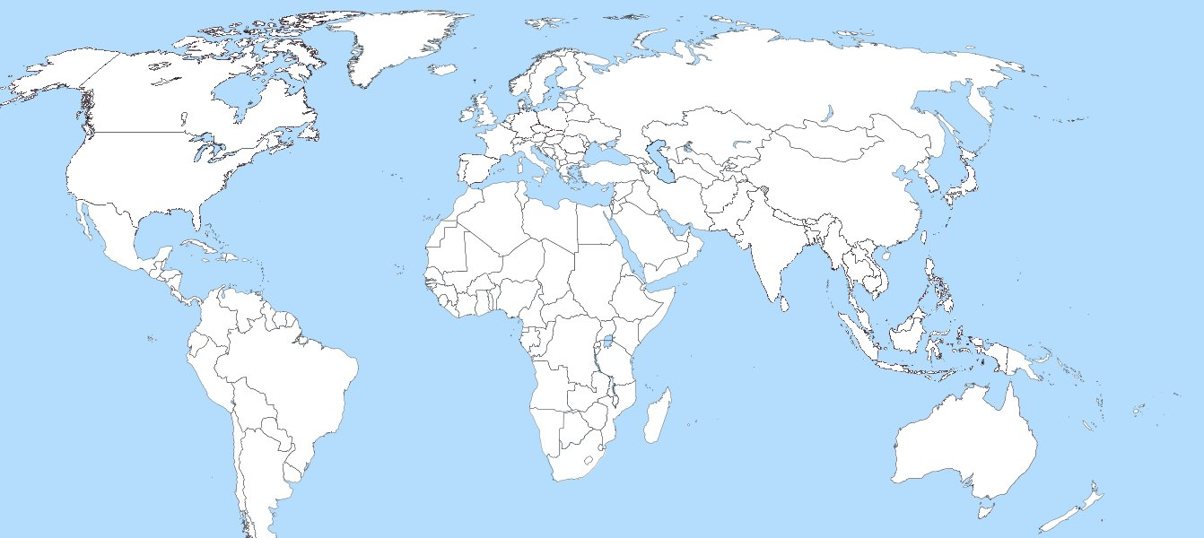
The Geography in Kensuke’s Kingdom

