Slide 1
Types of Numbers
There are many different ways that we can categorise/label/group numbers.
What are some of the ways you that that we can categorise numbers?

Slide 2
Types of Numbers
There are many different ways that we can categorise/label/name numbers.
Odd
Even
Whole number
Decimal
Square
Cubed
Triangular
Prime
Composite
Negative
Positive
Fibonacci
Some of these numbers have special properties and these properties can be used to solve problems (which you will discover later).

Slide 3
Types of Numbers
What type of numbers do you see?

Slide 4
Types of Numbers: Square Numbers
Square Numbers!
Why do you think these are called square numbers?

Slide 5
Types of Numbers: Square Numbers
2x2=4
3x3=9
4x4=16
5x5=25
6x6=36
1x1 = 1
Because the multiplication of an integer (number) by itself forms a square shape or array!
1x1 = 1
2x2=4
3x3=9
4x4=16
5x5=25
6x6=36

Slide 6
Types of Numbers: Square Numbers
2x2=4
3x3=9
4x4=16
5x5=25
6x6=36
1
Have you ever heard of the term “squared” or seen this:
2
4

Slide 7
Types of Numbers: Square Numbers
2x2=4
3x3=9
4x4=16
5x5=25
6x6=36
1
The term “squared” or this (to the power of 2):
2
4
means a number multiplied by itself:
E.g. 1x1, 2x2, 7x7, 9x9

Slide 8
Types of Numbers: Square Numbers
1
4
9
16
25
36
Square Numbers!
1, 4, 9, 16, 25, 36, …., …., ….
Heading: Square Numbers
Draw this pattern in your book and copy the counting pattern.
Show the for each picture.
Continue the pattern to find out what the next 5 numbers are
in this pattern.
4 = 4x4 = 16
2

Slide 9
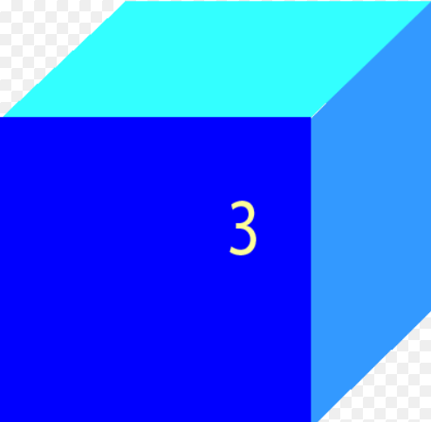
Have you ever seen this:
3
4
What does the little three (³) mean?
Cubed!

Slide 10
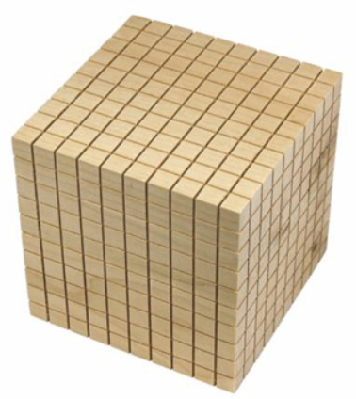
Types of Numbers:
Cubed Numbers/To The Power of 3
The term “cubed” or “to the power of 3”:
3
4
means a number multiplied by itself and then by itself again:
10
E.g.
1³ = 1x1x1 =
2³ = 2x2x2 =
7³ = 7x7x7 =
9³ = 9x9x9 =
10³ = 10x10x10 =
10
10

Slide 11
Types of Numbers:
Cubed Numbers/To The Power of 3
You can use brackets to help you solve powers of equations:
49
7³ = (7x7)x7 =
343
10
81
9³ = (9x9)x9 =
729
100
10
10³ = (10x10)x10=
1000
10

Slide 12
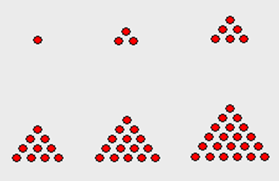
Types of Numbers
What type of numbers do you see?

Slide 13
Types of Numbers: Triangular Numbers
Triangular Numbers!

Slide 14
Types of Numbers: Triangular Numbers
Does anyone know why they are called triangular numbers?

Slide 15
Types of Numbers: Triangular Numbers
Because the multiplication of an integer (number) by itself forms an equilateral triangular or array!

Slide 16
Types of Numbers: Triangular Numbers
1
3
6
10
15
21
Triangular Numbers!
1, 3, 6, 10, 15, 21, …., …..
Heading: Triangular Numbers
1. Draw this pattern in your book and copy the counting pattern.
2. Continue the pattern to find out what the next 5 numbers in this triangular number pattern are.

Slide 17
Types of Numbers: Triangular Numbers
Triangular Numbers:
1, 3, 6, 10, 15, 21, …., …..
Heading: Triangular Number Rule
Could you figure out what the rule is if you were asked to find the next 10 numbers but you had to do it without drawing or counting on in your head? Good luck!

Slide 18
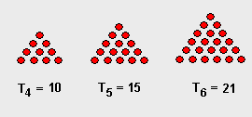
Types of Numbers: Triangular Numbers
Triangular Numbers:
1, 3, 6, 10, 15, 21, …., …..
Triangular Number Rule

Slide 19
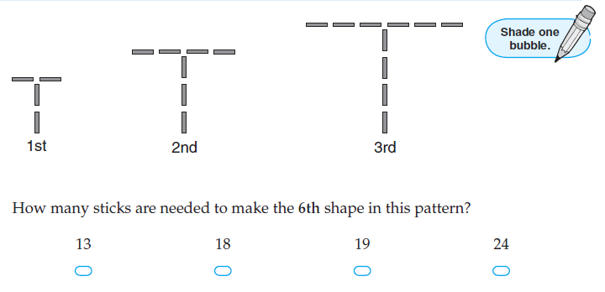
Extension:

Slide 20
Extension:

Slide 21
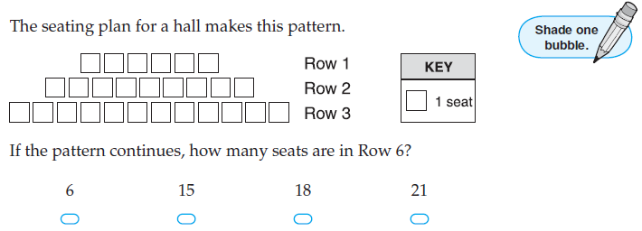
Extension:

Slide 22
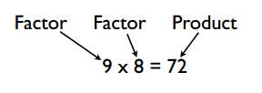
Before we look at the next types of numbers it’s important to remind or teach you the following mathematical vocabulary!
Can you give us an example of 2 factors and their product?

Slide 23
Heading: Factors and Products
Create at least ten multiplication equations using the following table:
Factor 1 (Multiplier 1) | Factor 2 (Multiplier 2) | Product (Answer)
2 | 3 | 6

Slide 24
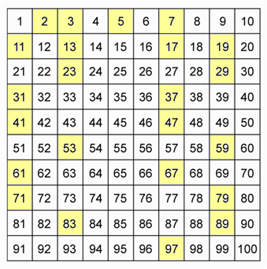
Types of Numbers
What type of numbers do you see?

Slide 25
Types of Numbers: Prime Numbers
Prime Numbers!

Slide 26
Types of Numbers: Prime Numbers
Have you ever heard of the term “prime” numbers?

Slide 27
Types of Numbers: Prime Numbers
Prime numbers are numbers that can only be
divided by
1, or
themselves
to equal a whole number.
Go through an example here:
WT?

Slide 28
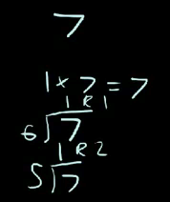
Types of Numbers: Prime Numbers
Prime numbers are numbers that can only be
divided by
1, or
themselves
to equal a whole number.
That’s easy!
So 7 can only be divided by 7 or 1 to get a whole number!
That means 7 is a prime number!

Slide 29
Types of Numbers: Prime Numbers
ALSO KNOWN AS:
A prime number is a number that only has two factors: 1 and the number
(i.e. 53: can only be made of 1x53)
Go through an example here:
WT?

Slide 30
Types of Numbers: Prime Numbers
ALSO KNOWN AS:
A prime number is a number that only has two factors: 1 and the number
(i.e. 53: can only be made of 1x53)
That’s easy!
So 7 can only be made using two factors: 7 and 1 (7x1).
That’s why we can call it a prime number!

Slide 31
Types of Numbers: Prime Numbers
Prime numbers are numbers that can only be
divided by
1, or
themselves
to equal a whole number.
2 ÷ 2 = 1
2 ÷ 1 = 2
These numbers can only every be divided by 1 or themselves to get a whole number!
3 ÷ 3 = 1
3 ÷ 1 = 3
59 ÷ 59 = 1
59 ÷ 1 = 59

Slide 32
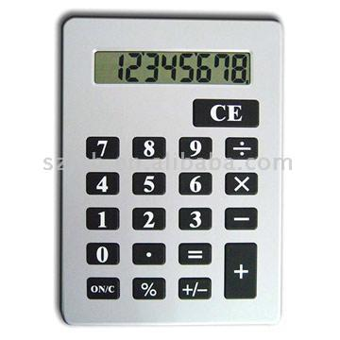
Types of Numbers: Prime Numbers
Let’s test that out!
Choose any number form here (i.e. 47).
On your calculator try:
47 ÷ 46 =
47 ÷ 45 =
47 ÷ 44 =
Keep on trying until you get a whole number!

Slide 33
Types of Numbers: Prime Numbers
Prime Numbers
Is there be a quicker way?

Slide 34
Types of Numbers: Prime Numbers
Prime Numbers
Yes!!
Try to draw any of these prime numbers in an array.

Slide 35
Types of Numbers: Prime Numbers
Prime Numbers
What’s an array?

Slide 36
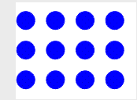
Types of Numbers: Prime Numbers
Prime Numbers
&
Arrays
Remember doing these in grade 2? (They are called arrays!)
6 x 2
Or
2 x 6
12 ÷ 2 = 6
or
12 ÷ 6 = 2
4 x 3
Or
3 x 4
12 ÷ 4 = 3
or
12 ÷ 3 = 4

Slide 37
Types of Numbers: Prime Numbers
Prime Numbers
&
Arrays
Try to make an array for any of these prime numbers!
Good luck!

Slide 38
Types of Numbers: Prime Numbers
Prime Numbers
Is there be a quicker way than drawing?

Slide 39
Types of Numbers: Prime Numbers
Prime Numbers
Yes!!
Check out the awesome way on the following slides….

Slide 40
Take out the number 1 because it is a special number.
Types of Numbers: Prime Numbers
1 | 2 | 3 | 4 | 5 | 6 | 7 | 8 | 9 | 10
11 | 12 | 13 | 14 | 15 | 16 | 17 | 18 | 19 | 20
21 | 22 | 23 | 24 | 25 | 26 | 27 | 28 | 29 | 30
31 | 32 | 33 | 34 | 35 | 36 | 37 | 38 | 39 | 40
41 | 42 | 43 | 44 | 45 | 46 | 47 | 48 | 49 | 50
51 | 52 | 53 | 54 | 55 | 56 | 57 | 58 | 59 | 60
61 | 62 | 63 | 64 | 65 | 66 | 67 | 68 | 69 | 70
71 | 72 | 73 | 74 | 75 | 76 | 77 | 78 | 79 | 80
81 | 82 | 83 | 84 | 85 | 86 | 87 | 88 | 89 | 90
91 | 92 | 93 | 94 | 95 | 96 | 97 | 98 | 99 | 100

Slide 41
Take out numbers that have a composite factor of 2
Types of Numbers: Prime Numbers
 | 2 | 3 | 4 | 5 | 6 | 7 | 8 | 9 | 10
11 | 12 | 13 | 14 | 15 | 16 | 17 | 18 | 19 | 20
21 | 22 | 23 | 24 | 25 | 26 | 27 | 28 | 29 | 30
31 | 32 | 33 | 34 | 35 | 36 | 37 | 38 | 39 | 40
41 | 42 | 43 | 44 | 45 | 46 | 47 | 48 | 49 | 50
51 | 52 | 53 | 54 | 55 | 56 | 57 | 58 | 59 | 60
61 | 62 | 63 | 64 | 65 | 66 | 67 | 68 | 69 | 70
71 | 72 | 73 | 74 | 75 | 76 | 77 | 78 | 79 | 80
81 | 82 | 83 | 84 | 85 | 86 | 87 | 88 | 89 | 90
91 | 92 | 93 | 94 | 95 | 96 | 97 | 98 | 99 | 100

Slide 42
Take out numbers that have a composite factor of 2
Types of Numbers: Prime Numbers
 | 2 | 3 |  | 5 |  | 7 |  | 9
11 |  | 13 |  | 15 |  | 17 |  | 19
21 |  | 23 |  | 25 |  | 27 |  | 29
31 |  | 33 |  | 35 |  | 37 |  | 39
41 |  | 43 |  | 45 |  | 47 |  | 49
51 |  | 53 |  | 55 |  | 57 |  | 59
61 |  | 63 |  | 65 |  | 67 |  | 69
71 |  | 73 |  | 75 |  | 77 |  | 79
81 |  | 83 |  | 85 |  | 87 |  | 89
91 |  | 93 |  | 95 |  | 97 |  | 99

Slide 43
Take out numbers that have a composite factor of 4
Types of Numbers: Prime Numbers
 | 2 | 3 |  | 5 |  | 7 |  | 9
11 |  | 13 |  | 15 |  | 17 |  | 19
21 |  | 23 |  | 25 |  | 27 |  | 29
31 |  | 33 |  | 35 |  | 37 |  | 39
41 |  | 43 |  | 45 |  | 47 |  | 49
51 |  | 53 |  | 55 |  | 57 |  | 59
61 |  | 63 |  | 65 |  | 67 |  | 69
71 |  | 73 |  | 75 |  | 77 |  | 79
81 |  | 83 |  | 85 |  | 87 |  | 89
91 |  | 93 |  | 95 |  | 97 |  | 99

Slide 44
Take out numbers that have a composite factor of 4
Types of Numbers: Prime Numbers
 | 2 | 3 |  | 5 |  | 7
11 |  | 13 |  |  |  | 17 |  | 19
 |  | 23 |  | 25 |  |  |  | 29
31 |  |  |  | 35 |  | 37
41 |  | 43 |  |  |  | 47 |  | 49
 |  | 53 |  | 55 |  |  |  | 59
61 |  |  |  | 65 |  | 67
71 |  | 73 |  |  |  | 77 |  | 79
 |  | 83 |  | 85 |  |  |  | 89
91 |  |  |  | 95 |  | 97

Slide 45
Take out numbers that have a composite factor of 5
Types of Numbers: Prime Numbers
 | 2 | 3 |  | 5 |  | 7
11 |  | 13 |  |  |  | 17 |  | 19
 |  | 23 |  | 25 |  |  |  | 29
31 |  |  |  | 35 |  | 37
41 |  | 43 |  |  |  | 47 |  | 49
 |  | 53 |  | 55 |  |  |  | 59
61 |  |  |  | 65 |  | 67
71 |  | 73 |  |  |  | 77 |  | 79
 |  | 83 |  | 85 |  |  |  | 89
91 |  |  |  | 95 |  | 97

Slide 46
Take out numbers that have a composite factor of 5
Types of Numbers: Prime Numbers
 | 2 | 3 |  | 5 |  | 7
11 |  | 13 |  |  |  | 17 |  | 19
 |  | 23 |  |  |  |  |  | 29
31 |  |  |  |  |  | 37
41 |  | 43 |  |  |  | 47 |  | 49
 |  | 53 |  |  |  |  |  | 59
61 |  |  |  |  |  | 67
71 |  | 73 |  |  |  | 77 |  | 79
 |  | 83 |  |  |  |  |  | 89
91 |  |  |  |  |  | 97

Slide 47
Take out numbers that have a composite factor of 7
Types of Numbers: Prime Numbers
 | 2 | 3 |  | 5 |  | 7
11 |  | 13 |  |  |  | 17 |  | 19
 |  | 23 |  |  |  |  |  | 29
31 |  |  |  |  |  | 37
41 |  | 43 |  |  |  | 47 |  | 49
 |  | 53 |  |  |  |  |  | 59
61 |  |  |  |  |  | 67
71 |  | 73 |  |  |  | 77 |  | 79
 |  | 83 |  |  |  |  |  | 89
91 |  |  |  |  |  | 97

Slide 48
Take out numbers that have a composite factor of 7
Types of Numbers: Prime Numbers
 | 2 | 3 |  | 5 |  | 7
11 |  | 13 |  |  |  | 17 |  | 19
 |  | 23 |  |  |  |  |  | 29
31 |  |  |  |  |  | 37
41 |  | 43 |  |  |  | 47
 |  | 53 |  |  |  |  |  | 59
61 |  |  |  |  |  | 67
71 |  | 73 |  |  |  |  |  | 79
 |  | 83 |  |  |  |  |  | 89
 |  |  |  |  |  | 97

Slide 49
The PRIME Numbers!
 | 2 | 3 |  | 5 |  | 7
11 |  | 13 |  |  |  | 17 |  | 19
 |  | 23 |  |  |  |  |  | 29
31 |  |  |  |  |  | 37
41 |  | 43 |  |  |  | 47
 |  | 53 |  |  |  |  |  | 59
61 |  |  |  |  |  | 67
71 |  | 73 |  |  |  |  |  | 79
 |  | 83 |  |  |  |  |  | 89
 |  |  |  |  |  | 97

Slide 50
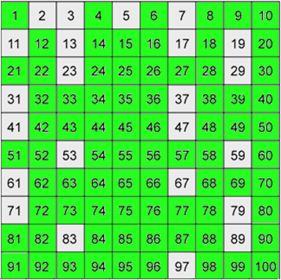
Types of Numbers
Prime numbers
??
What do you think the green numbers are?

Slide 51
Types of Numbers: Composite Numbers
Composite Numbers!

Slide 52
Types of Numbers: Composite Numbers
Have you ever heard of the term “composite” numbers?

Slide 53
Types of Numbers: Composite Numbers
Composite numbers are numbers that can be
divided by
at least two numbers, and
themselves
to equal a whole number.
WT?

Slide 54
Types of Numbers: Composite Numbers
Composite numbers are numbers that can be
divided by
at least two numbers, and
themselves
to equal a whole number.
That’s easy!
So 7 can only be made using two factors: 7 and 1 (7x1).
That’s why we can call it a prime number!

Slide 55
Types of Numbers: Composite Numbers
Also known as:
Composite numbers are numbers that have more than one factor (e.g. 9 = 3x3 and 9x1)
WT?

Slide 56
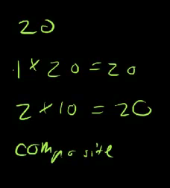
Types of Numbers: Composite Numbers
Also known as:
Composite numbers are numbers that have more than one factor (e.g. 9 = 3x3 and 9x1)
That’s easy!
So 20 can be made using more than two factors: 1 & 20 (1x20) 2 & 10 (2x10) and
4 & 5 (4 x 5).
That’s why we can call it a composite number!

Slide 57
Types of Numbers: Composite Numbers
Let’s test the division theory out!
Choose any green number (i.e. 99).
On your calculator try:
99 ÷ 12 =
99 ÷ 11 =
Heading: Composite Numbers
If you find a number that your number can be divided by write it into your book.
For example: 99 can be divided by 11: 99 ÷ 11 = 9

Slide 58
Types of Numbers: Composite Numbers
Let’s test the factors theory out!
Choose any green number (i.e. 20).
List all the factors of that number you know
(i.e. 20 = 4x5, 2x10, 1x20)
Heading: Composite Numbers
If you find a number that your number can be divided by write the factors into your book.
For example: 99 = 11 x 9
99 = 33 x 3 etc..

Slide 59
Types of Numbers
What do you think you get if you multiply a prime number by a prime number? (Try it a few times using the prime numbers in the box below)
prime number x prime number = ?

Slide 60
Types of Numbers
Did you know that if you multiply a prime number by a prime number you get a composite number!
When you multiple a prime
number by a prime number we
then call them “prime factors”
? X ? = Factor x factor
2 and 3 (2 x 3) are prime factors!
Heading: Prime Factors
Create at least ten multiplication equations that use only prime factors (prime number x a prime number)

Slide 61
Prime Factors
Heading: Prime Factors
Create at least ten multiplication equations that use only prime factors (prime number x a prime number) using the following table layout:
Prime Factor 1 | Prime Factor 2 | Answer (Composite Number)
2 | 3 | 6

Slide 62
Prime Factors
Let’s see which students really understand prime factors!
Read the following sentence carefully! What is it really asking you?
You have 5 minutes to write down all of the prime factors (not factors, prime factors) for the number 100.

Slide 63
Prime Factors: Method 1
What are the prime factors for the number 100.
A prime factor is (a factor that is also a prime number).
Therefore the prime factors of 100 are 2 & 5
(1, 10, 20, 25 ,50 and 100 are not: they are composite numbers)
Why are 2 and 5 the only prime factors of 100?
The 9 factors of 100 are 1, 2, 4, 5, 10, 20, 25, 50, and 100 (The factor pairs of 100 are 1 x 100, 2 x 50, 4 x 25, 5 x 20, and 10 x 10).
Therefore out of all of those factors of 100 only 2 and 5 are prime numbers (prime factors).

Slide 64
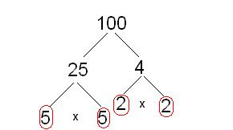
Prime Factors: Method 2
What are the prime factors for the number 100.
Factor trees can help us identify the prime factors.
x
.
.
.
.
Check out your answers using this free online prime factors calculator:
http:÷÷www.analyzemath.com÷Calculators_3÷prime_factors.html

Slide 65
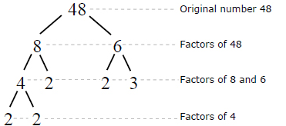
Prime Factors: Factor Trees
Factor trees can help us identify the prime factors
.
Heading: Factor Trees
.
.
Activity:
Try to create your own factor tree for the number 30. Remember: Only use prime numbers as factors (multipliers)
.
http:÷÷calculator.tutorvista.com÷math÷486÷factor-tree-calculator.html#

Slide 66
Did you know?
That if a number is divisible (able to be divided by) by a composite number then…. it is also divisible by the prime factors of that number!
and 4)
WT?
For example
Choose a random number: 785
The last two digits of 785 are 85.
85 is divisible by 5! (don’t worry about the 700; 100 is a composite number therefore so is 700!)

Slide 67
Let’s try that again with another random number.
For example
Choose a random number: 216
The last two digits of 216 are 16.
16 is divisible by 8!
AND
216 is also divisible by 2.
(Remember, don’t worry about the 200; 100 is a composite number therefore so is 200!)

