Slide 1
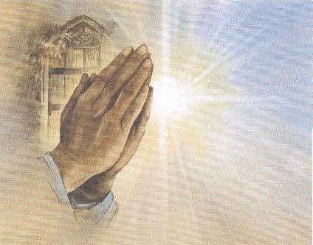
Prayer & Me: Prayer in Today’s World
Prayer is the relationship between the self and God. So let’s take a closer look at what prayer can look life.
Adapted from Joan Chittiser, ‘The breath of the soul: Reflections on prayer’

Slide 2
Part 1
Prayer & Action

Slide 3
Prayer & Action
What does prayer mean to you?
Do you pray?
What do you pray for?
What are the types of prayers that you know?

Slide 4
Types of Prayer
There exists many types of prayer:
intercession/petition (asking)
forgiveness/sorrow
thanksgiving
praise.
There is liturgical prayer which is the public prayer of the gathered Church. It centres around the Eucharist and the other sacraments and the Liturgy of the Hours: the daily prayer of the Church prayed by priests and religious, and many lay people too.
There is the great treasury of learned prayers which can be prayed either together or alone. These include the Our Father, the Hail Mary, the Glory be, the Apostles’ Creed, parts of the psalms and prayers such as the Angelus and the Rosary.
There is meditative prayer in which, using an idea, an image or a scripture text, people quietly open themselves to the presence of God. Ways of meditative prayer are meditation on a text, an icon, recitation of the Rosary, the Jesus Prayer, prayerful movement or art or play, Taizé chants, Lectio Divina.
There is contemplative prayer which is the opening of our whole being to God, the Ultimate Mystery, who is beyond thoughts, words and emotions; whom we know by faith is within us, closer than breathing, thinking, feeling and choosing; even closer than consciousness itself. Contemplative pPrayer is wordless – a prayer of silence and longing and union.
There is also spontaneous prayer which arises from the ordinary events and experiences of life and which connects them and us to God.

Slide 5
Prayer & JESUS
What did Jesus pray for?
When did he pray?
Who did Jesus pray with?
What were Jesus’ teachings on prayer?
To find these answers, use Bible Study Tools Online to search the Gospels for references to the word ‘pray’. This will help us understand the role prayer played in the life, times and teachings of Jesus.

Slide 6
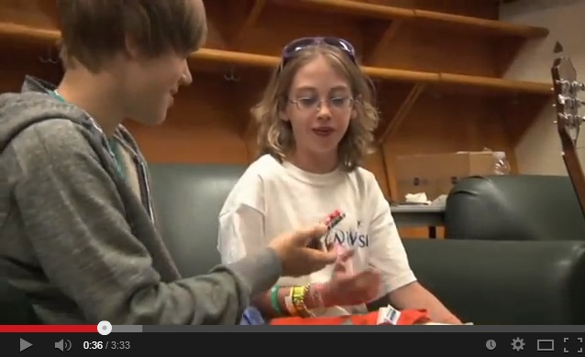
Prayer & Action
What does Justin Bieber pray for?
Justin Bieber prays for:

Slide 7
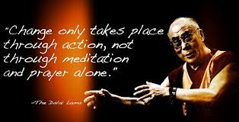
Prayer & Action
Too often we pray for:
intercession/petition (asking)
forgiveness/sorrow
thanksgiving
praise.
If we pray and we don’t receive it can lead to a break in faith. Therefore we should pray
that the spirit of God is with us, regardless of whether we success or not.
‘I prayed for twenty years but received no answer until I prayed with my legs.’
(Frederick Douglas, Escaped slave)
We should get up and do it ourselves, instead of praying for it to happen and being disappointed when it does not. So we should pray for the
strength to be courageous
endurance
the quality of the character we need so that we can….

Slide 8
Prayer: a reflection on…
Write a reflective piece, noting:
What is the new religious topic?
What did we watch? How did you feel?
What is prayer for you?
What learning did you take from today’s lesson?

Slide 9
Part 2
Prayer: responsibility

Slide 10
Prayer: responsibility
What did we talk about during the previous Religion lesson?
What is active prayer?
What role does responsibility play in active prayer?

Slide 11
Prayer: responsibility
When God put humankind into a garden called Earth, it was, Scripture was clear, to steward it to the fullness of life.
GENESIS 1:2
God blessed them and said, “Bear fruit, increase your numbers, and fill the earth-and be responsible for it. Watch over the fish of the sea, the birds of the air, and all the living things on earth.
We were intended to keep the Earth in good condition, to use it and develop it, to be fruitful and multiply and uses its creative energies to do our part in bringing every aspect of creation to fulfillment.
What God did not complete, we are meant to finish. God gave us the plants and intends us to garden and harvest them for the good of the entire world. God gave us the sun and intends us to use its energies in ways that maintain, not destroy life. God gave us the raw materials of life (physical, psychological and mental) and expects us to bring to full growth what was created in embryo. Therefore we are each workers in the garden of life.
To be ensured that we are living an authentic prayer life, we must forever and always examine the fruits and gifts of the holy spirit within us.
MANTRA: God, I pray that I have the grace to “till and keep” the part of the world that you have given into my care.

Slide 12
Prayer: responsibility
If we are responsible for tending to God’s garden (the world), how can students and schools actually make a difference in the world through active prayer?
Let’s take a look at one group of students from Ringwood North Primary School helped a community recover from a natural disaster.

Slide 13
Prayer: responsibility
So how can we actually make a difference in the world through active prayer?
What things could you do as students and we as a school that could be examples of active prayer: getting up and making a difference through our actions?

Slide 14
Prayer: responsibility
WHOSE CHILD IS THIS? Author Unknown
"Whose child is this?" I asked one day, seeing a little one out at play. "Mine", said the parent with a tender smile, "Mine to keep a little while. To bathe their hands and comb their hair. To tell them what they are to wear. To prepare them that they may always be good, and each day do the things they should." "Whose child is this?" I asked again, as the door opened and someone came in. "Mine", said the teacher with the same tender smile. "Mine, to keep just for a little while. To teach them how to be gentle and kind. To train and direct their dear little mind. To help them live by every rule, and get the best they can from school."
"Whose child is this?" I ask once more, just as the little one entered the door. "Ours" said the parent and the teacher as they smiled, and each took the hand of the little child "Ours to love and train together. Ours this blessed task forever."
Together we pray:
Lord, please help me, To strengthen their voices, bodies and minds, To express their feelings and control them sometimes, To explore what's near and venture afar, But most important to love who they are.
Amen
Students, parents and teachers, schools and the church all have a shared responsibility in the teaching and learning process.

Slide 15
Prayer: a reflection on…
Write a reflective piece, noting:
What learning did you take from today’s lesson?
What wonderings do you have?

Slide 16
Part 3
Prayer: Know thyself

Slide 17
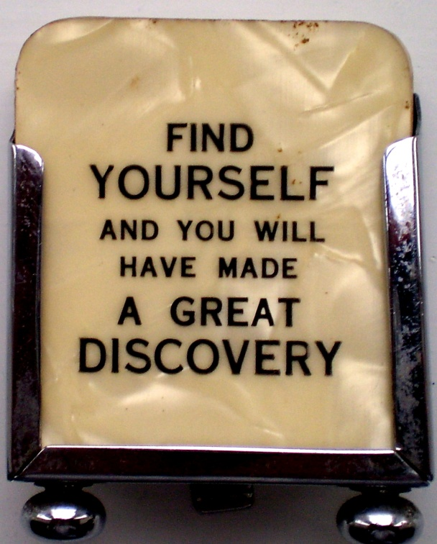
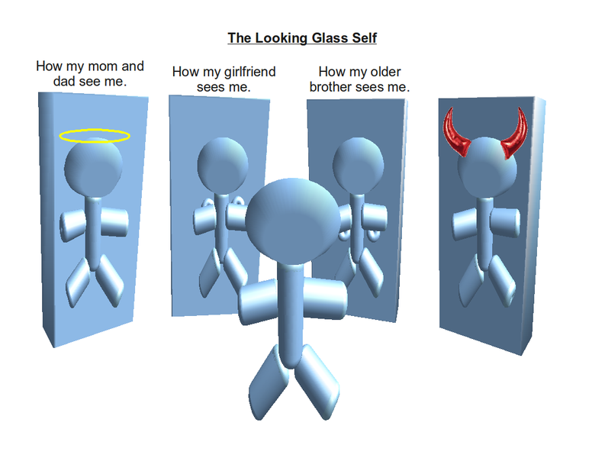
Prayer: Know thyself
To grow spiritually, one cannot hide from one’s self; therefore one must pray for self knowledge (know thyself) and the self-honesty that, with the grace of God, can bring one close to the heart of God. Self-knowledge saves us from ourselves.
MANTRA: God, I pray that I have honesty to be honest with myself, and know thyself, so I can make positive growth and change.

Slide 18
Part 3
Prayer: Know thyself
Insert activity

Slide 19
Prayer: a reflection on…
Write a reflective piece, noting:
What learning did you take from today’s lesson?
What wonderings do you have?

Slide 20
Part 4
Prayer: Enthusiasm for life

Slide 21
Prayer: Enthusiasm for life
Life can astonish us! It can be full of surprises and unsettling twists and turns. How can our souls absorb such things? How can our minds make sense of them? How can we possibly respond to them?
Those are not easy questions. They require that we make some decisions about the nature of life itself; is life only random? Does nothing explain the unexplainable? Is there such a thing as destiny? Are we at the mercy of fate? Are we simply pawns in the senseless spinning of an erratic universe?
When we do not cultivate a sense of surprise or zest for life, we give into the emotional dysfunction that suffocates the breath of life in us and lack the open-armed exuberance for life that makes the human, human. If we miss the little things, we will soon begin to take love, friendship and blessing for granted.
Let’s pray for the spiritual consciousness of the unexpected so that life at work in us can astonish us with its real fullness.
MANTRA: God, I pray that I show the gift to live with enthusiasm, to accept life with open and trusting arms.

Slide 22
Part 4
Prayer: Enthusiasm for life
Insert activity

Slide 23
Prayer: a reflection on…
Write a reflective piece, noting:
What learning did you take from today’s lesson?
What wonderings do you have?

Slide 24
Part 5
Prayer: SELF Discipline and presence

Slide 25
Prayer: SELF Discipline and presence
At no time of day or night are we not thinking about something. The only real question is, ‘Where does my mind go?’ The question is an important one because the answer defines the kind of person we are choosing to become.
Buddhists call it “taming the monkey mind”. We call it the need to resist distractions.
MANTRA: God, I pray that my mind can concentrate on the task at hand so that I can develop myself in a positive manner.
If we scheme dark thoughts (however place and positive we appear to others), we are darkness walking. If one allows anger to take root and fester within, one will become anger. In the same way, one can become jealous, greed, gluttony, envy, pride and sloth. What one immerses oneself in, they will become.
What we think about during the waking-hours shapes you. What one puts into their soul is what will shape oneself. Therefore one must pray to become love.
MANTRA: God, I pray that I can continue to develop the ability to be loving and positive in this world, no matter what I encounter.

Slide 26
Part 5
Prayer: SELF Discipline and presence
Insert activity

Slide 27
Prayer: a reflection on…
Write a reflective piece, noting:
What learning did you take from today’s lesson?
What wonderings do you have?

Slide 28
Part 6
Prayer: Body, Mind & Soul

Slide 29
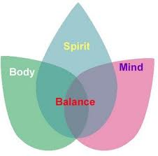
Prayer: Mind, body & soul
Prayer, like a laser beam, concentrates the mind and enlarges the soul. By calling us to view a life larger than the present moment, it deepens the meaning of both the material and the spiritual worlds. Scientists tell us that matter and spirit are made up of the very same molecules. One is not a different substance than the other. Therefore, matter and spirit are then, the very same thing. The only difference is the density of the molecular structure.
Prayer is the soul-stretching process that bridges matter and spirit and binds us to the universe and makes us citizens of the cosmos.
JOHN 17:1.1-1.3
I have given them glory you gave me that they may be one, as we are on-I in them, you in me-that they may be perfect in unity.
MANTRA: God, I pray that I can continue to develop my spirituality, so that I can be one with the universe.

Slide 30
Part 6
Prayer: Body, Mind & Soul
Insert activity

Slide 31
Prayer: a reflection on…
Write a reflective piece, noting:
What learning did you take from today’s lesson?
What wonderings do you have?

Slide 32
Part 7
Prayer: humility

Slide 33
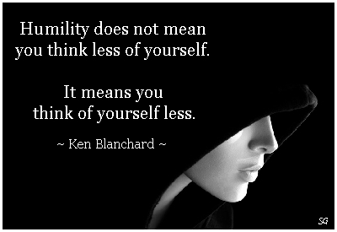
Prayer: humility
Each of us has something that the rest of the world needs. We are here to develop our gifts and share them with all.
If one does not know one’s gifts, how can they possibly develop them and fulfill the purpose of creation?
At the same time, it is entirely destructive, most of all to oneself, to presume that because one has a gift, that one has all gifts and that no one else has any. One’s gifts do not supersede others. Arrogance corrodes our awareness of the power of interdependence and makes it impossible to see our own needs.
CORINTHIANS 12:21
The eye cannot say to the hand, “I do not need you,” any more than the head can say to the feet, “I do not need you.”
Even those members of the body that seem less important are in fact indispensable. Therefore we must pray for the humility it takes to share our gifts and accept the gifts of others.
MANTRA: God, I pray that I can continue to develop humility, to see your greatness in others. Fill me with yourself so that I might be less full of myself!

Slide 34
Part 7
Prayer: humility
Insert activity

Slide 35
Prayer: a reflection on…
Write a reflective piece, noting:
What learning did you take from today’s lesson?
What wonderings do you have?

